Slide 1
QUARANTINE MONITORING SYSTEM
JAVA PROGRAMMING
BSIT 2C

Slide 2
SYSTEM INFORMATION & FUNCTION
The system was created to know the result of the patients quarantined days based on their daily symptoms. It records the patients information and then ask questions about them, having a symptoms for that specific day. The days that the patients needs to undergo is depends on their place of origin. Results are based on how they answered the questions.

Slide 3
SYSTEM FlOWCHART

Slide 4
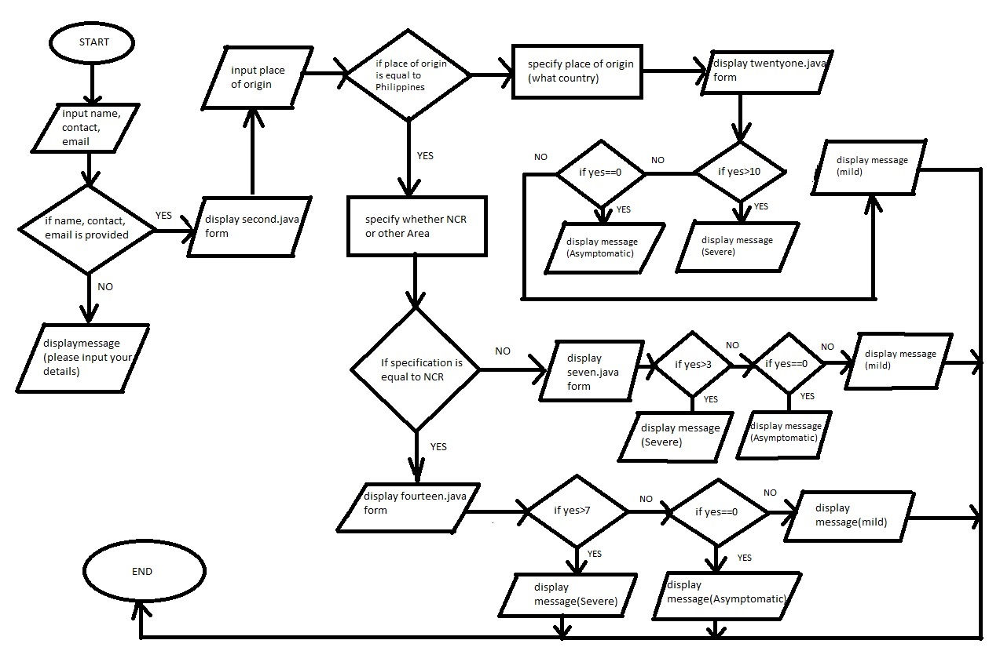

Slide 5
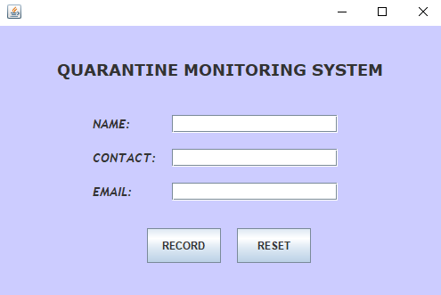
SYSTEM FUNCTIONS PER FORM

Slide 6
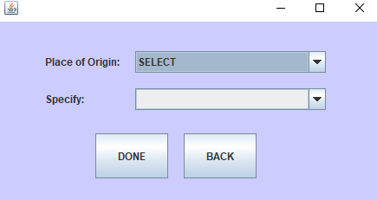
SYSTEM FUNCTIONS PER FORM

Slide 7
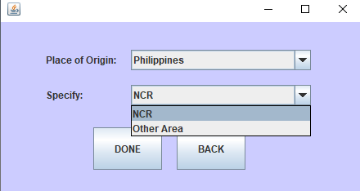
SYSTEM FUNCTIONS PER FORM

Slide 8
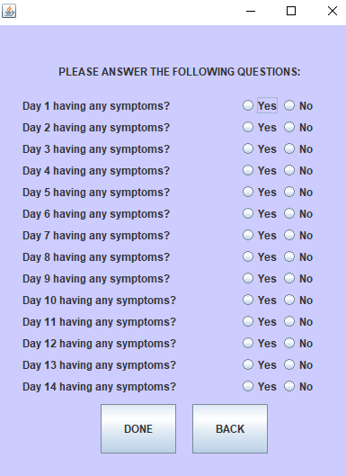
SYSTEM FUNCTIONS PER FORM

Slide 9
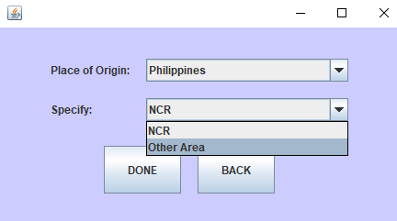
SYSTEM FUNCTIONS PER FORM

Slide 10
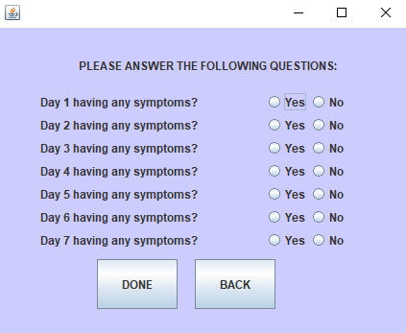
SYSTEM FUNCTIONS PER FORM

Slide 11
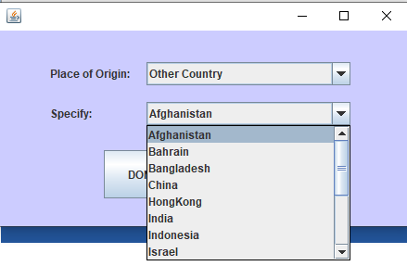
SYSTEM FUNCTIONS PER FORM

Slide 12
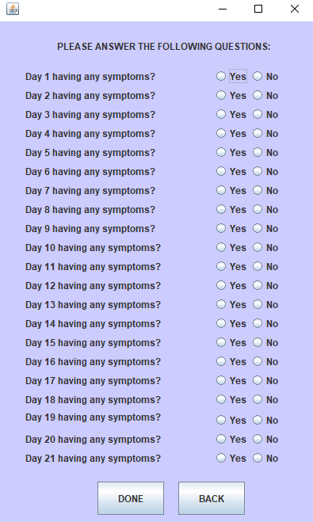
SYSTEM FUNCTIONS PER FORM

